Slide 1
Chapter 1 – Fluid Properties
CE30460 - Fluid Mechanics
Diogo Bolster

Slide 2
What is a Fluid?
A substance that deforms continuously when acted on by a shearing stress
A solid will deform to a certain point for a given stress
Liquids and Gases are fluids (water, oil, air)
Some substances can act as solids and fluids (e.g. soil standing/ avalanche)

Slide 3
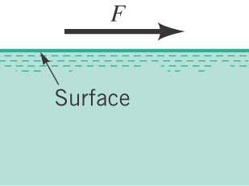
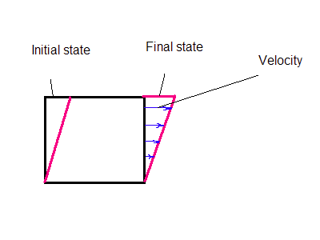
What happens for a fluid/solid ?

Slide 4
Units and Dimensions Important in Fluids
Primary Dimensions
Length (L)
Time (T)
Mass (M)
Temperature (Θ)
For any relationship A=B
Units (A)=Units (B) Dimensional Homogeneity
Notes:
In class example on the board

Slide 5
Systems of Units
British SI (Systeme International)
Foot (ft) Meter (m)
Second (s) Second (s)
Pound (lb) Kilogram (kg)
Degree Rankine (ºR) Degree Kelvin (ºK) related to Fahrenheit related to Celsius (ºF+459.67) (ºC+273.15)

Slide 6
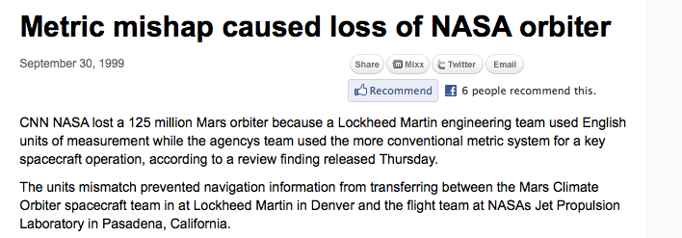
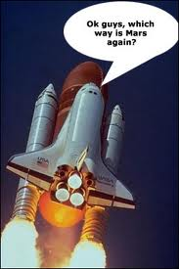
Why are Units so Important

Slide 7
Sample Problem 1 – Unit Homogeneity
Consider the formula
F – force, v – velocity, t – time, l – length
What are the unites of the K_{a,} K_{b} and K_{c} terms?

Slide 8
Fluid Mass and Weight
Density ρ [M L⁻³]
Varies with temperature and pressure
Liquid (often negligible changes)
Gasses (can be very important to account for changes)
Specific Volume (inverse density) v [L³ M⁻¹]
Specific Weight γ=ρ g [What are the units?]
Specific gravity SG=ρ/ρ_{water@4C} (i.e. 1 for water at 4ºC it equal to 1, for mercury 13.55, where the density of mercury would be 13550 kg m⁻³).

Slide 9
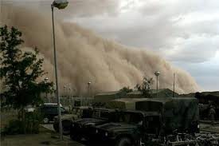
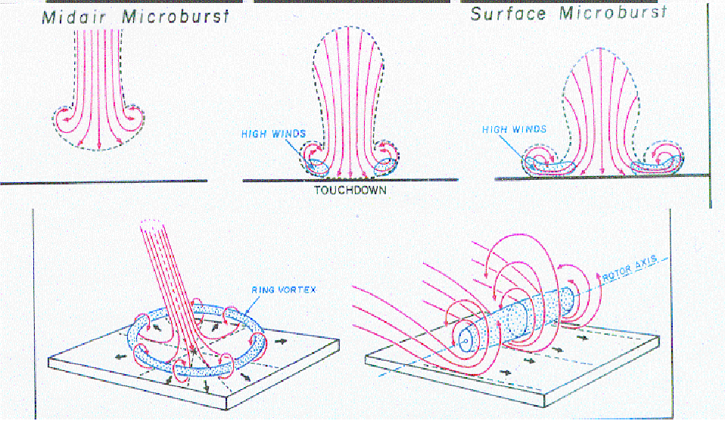
Density Effects (called buoyancy) can be very very important in Environmental Flows
Example 1 – Thunderstorm Fronts
Also http://video.google.com/videoplay?docid=8645834985308987314#

Slide 10
Sample Problem – Density
A volume of 1m^3 is occupied by two fluids. Fluid 1 has a specific gravity of SG=2, while Fluid 2 has a density of 800 kgm-3? There is three times as much mass of Fluid 2 as there is of Fluid 1.
How much mass is there of each fluid?
What volumetric fraction of the total volume does each fluid occupy?

Slide 11
Ideal Gases
Gases are much more compressible than liquids and their density is sensitive to changes in pressure and temperature. An ideal gas is one which follows the ideal gas law:
R – the gas constant depends on the particular gas in question.
http://intro.chem.okstate.edu/1314f00/laboratory/glp.htm
Pressure is a relative measurements and two common used measures in engineering are : Gauge vs. Absolute pressure (here we must use absolute)
Absolute is relative to absolute zero pressure
Gauge is measured relative to atmospheric (i.e. Absolute-Atmospheric)
Notes:
Example Problem on Ideal Gas Law

Slide 12
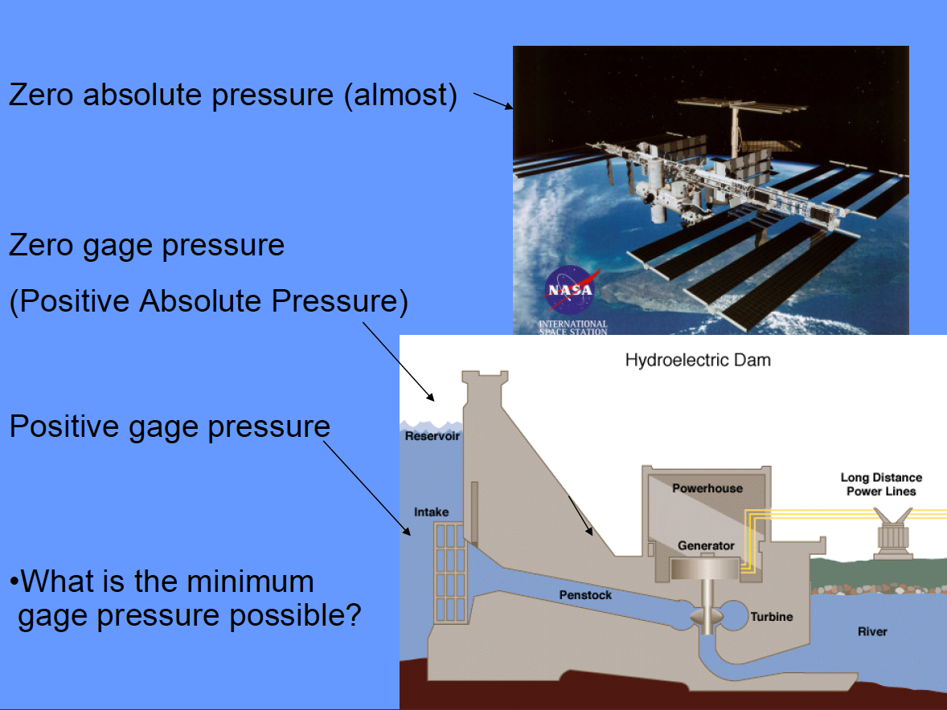
Pressure

Slide 13
Sample Problems – Ideal Gases
A lab is conducting experiments. The temperature is 27ºC and the pressure is 14 psia. What is the density of the air?
Express you answers in both slugs/ft³ and kg/m³
What happens if we conduct the same experiment at an altitude of 30000 feet. What are typical temperatures and pressures at that height. What will the density of air be up there?

Slide 14
Viscosity
Viscosity is a measure of a fluid’s resistance to shear – more viscous, more resistance
Intrinsic property of a fluid (varies with temperature)
Viscosity causes fluids to adhere to solid boundaries http://www.youtube.com/watch?v=TADz6fqfXo0
Observations show shear stress is proportional to velocity gradient
(Dynamic) Viscosity (μ) is the constant or proportionality s.t.
Kinematic Viscosity (ν=μ/ρ) is also commonly used in formulas.
Notes:
Discussion on what fluids are more viscou that others?
Differences between kinematic and dynamic

Slide 15
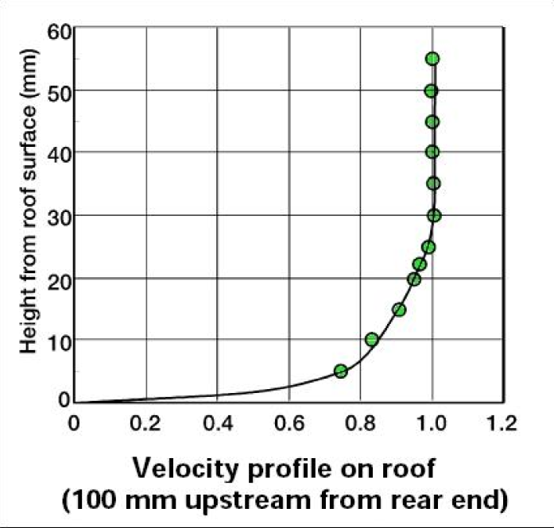
Velocity profile of air over a car roof
Where is the region of maximum shear stress?

Slide 16
Sample Problem – Shear Stress due to viscosity
You measure a velocity profile for water at 15.6ºC in the lab that can be fit with the polynomial
Calculate an expression for the shear stress? Plot it.
Where is it maximum? What is the value?
Where is it minimum? What is the value?

Slide 17

Compressibility
How much does the volume of a fluid change for a given change in pressure
Bulk Modulus
How is this different for gases and fluids?

Slide 18
Compression of Gases
Two common approaches are used
Isothermal (constant temperature) so from ideal gas law
Isentropic (no change in entropy, frictionless with no exchange of heat to surroundings)
For many gases k ~ 1.4
See table B3 and B4 in text

Slide 19
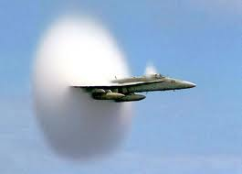
Speed of Sound
What is the speed of sound?
http://www.youtube.com/watch?v=QX04ySm4TTk

Slide 20
Speed of Sound
What is the speed of sound?
A measure of how quickly small disturbances propagate
What does this mean for speed
of sound in a liquid relative to a
gas?

Slide 21
Sample Problem – Speed of Sound in Water vs. Air
Which do you think is greater?
Calculate them…..

Slide 22
Surface Tension
Surface tension is a property of fluid that is important at interfaces between different fluids. The different molecular dynamics on each side of the interface lead to surface tension
How insects walk on water; how droplets form in a specific shape
Sensitive to changes in chemical composition (i.e. you can change surface tension easily by dissolving a solute in a fluid)
For a capillary rise
Notes:
Derive on blackboard

Slide 23
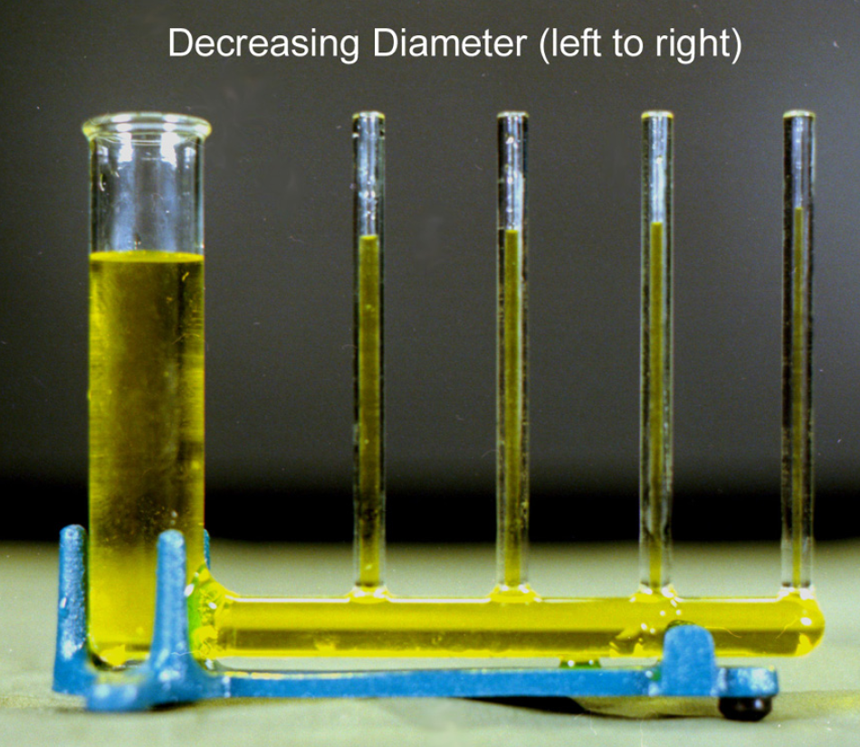
Capillary Rise

Slide 24
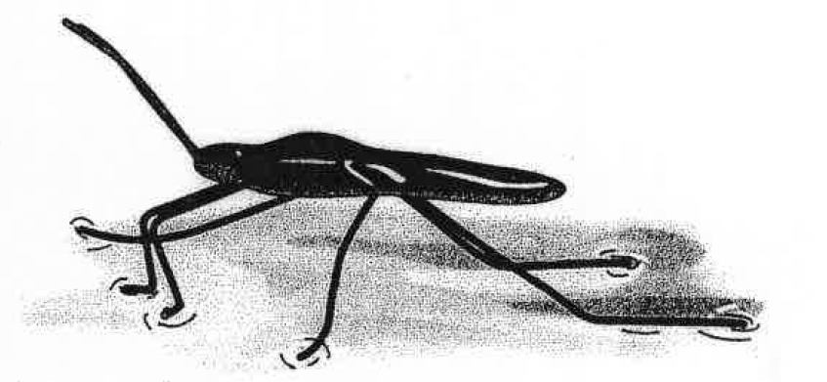
Sample Question – Walking on Water…
A water strider is supported on the surface of a pond by surface tension acting along the interface between the water and the bugs’ legs. Determine the minimum length of the interface needed to support tge bug
Assume the bug weighs 10⁻⁴ N and that surface tension acts only vertically upwards
Repeat the calculation for an average human weighing 750N

Slide 25
Important Equations
Specific Weight γ=ρg
Ideal Gas Law p=ρRT
Newtonian Fluid Shear Stress τ=μ du/dy
Bulk Modulus
Speed of Sound
Capillary Rise in a Tube

